Slide 1
Iowa Liquor Sale Analysis:
Improving liquor profits of the Iowa Alcoholic Beverage Division
BA 775 Team 4

Slide 2
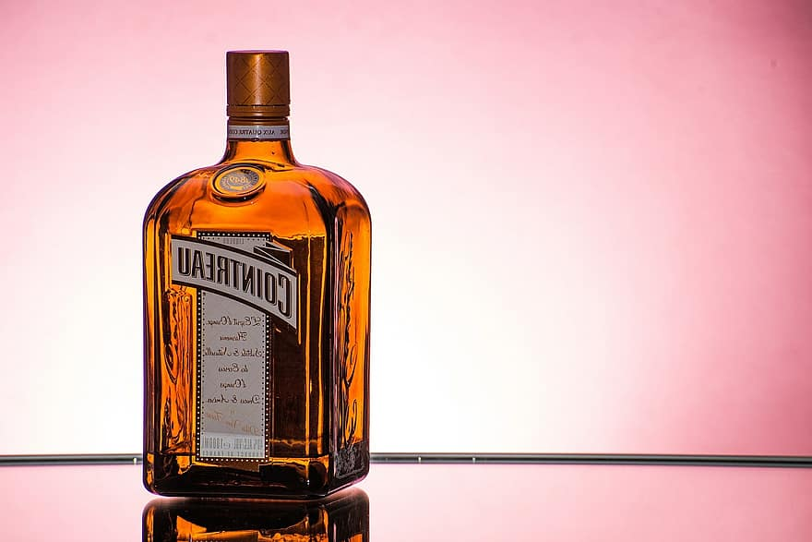
Agenda
Background and Problem
Revenue Analysis
Profit Analysis
Distribution Analysis
Our Recommendations
Q&A

Slide 3
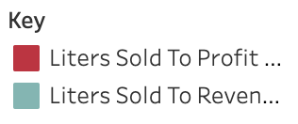
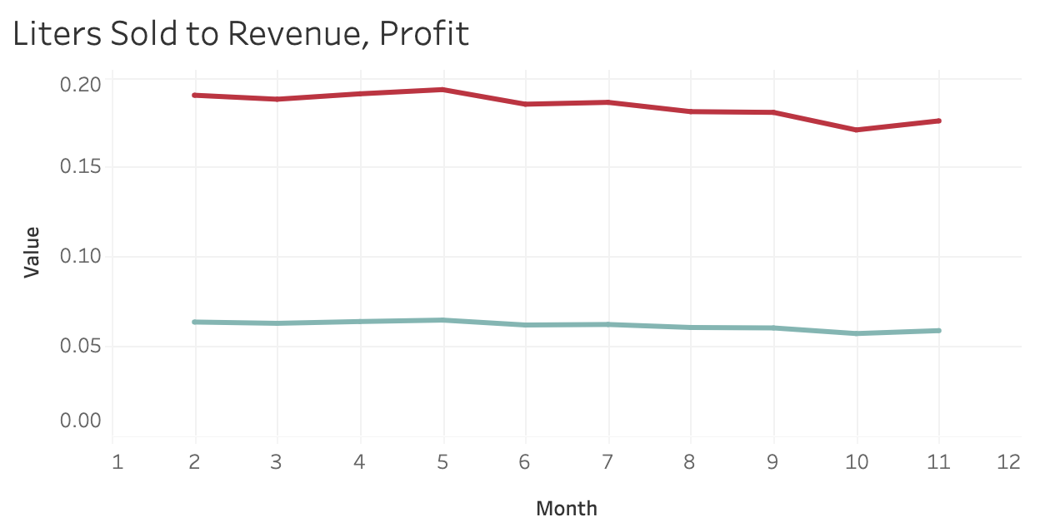
Background and Problem
Iowa liters sold to revenue/profit ratio trend
Iowa is a “liquor controlled” state.
The Iowa Alcoholic Beverage Division is in charge of all wholesale transactions of liquor between vendors and retail stores.
The government is not only interested in profit, but also protecting public welfare by regulating alcohol consumption
GOAL
Optimize profits while limiting volume of liquor distributed
Lower liters of liquor sold to profit ratio

Slide 4
Revenue Analysis

Slide 5
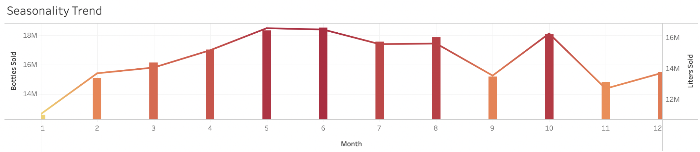
Demand Analysis
Most Demanded Liquor:
Whiskey, vodka, and rum are 3 liquor categories in highest demand in terms of revenue and bottles sold.
Seasonality:
Bottles sold tend to be in higher demand in the summer months (May-August)
Notes:
they should focus on these more popular categories when trying to maximize profit and limit demand

Slide 6
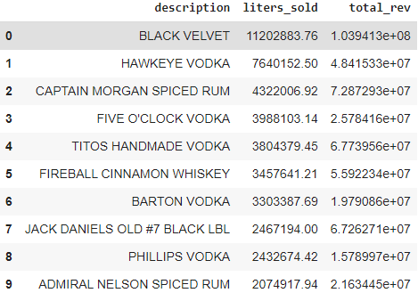
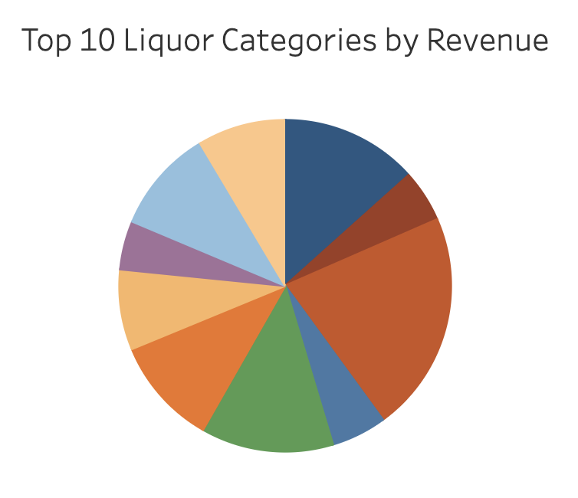
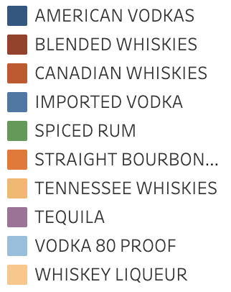
Revenue Analysis
Which items have the highest revenue vs liters sold?
Quantity demanded in terms of liters sold is a good measure but revenue is the key figure
Black Velvet Canadian Whisky is the most popular brand of liquor
Notes:
Thanks Jennifer,
Revenue or sales is a key figure into assessing a product or vendor’s performance related to profits. By analyzing the revenue of each liquor category, the Iowa Alcoholic Beverage Division can make informed decisions of managing and limiting volume sold and inventory on the top products / liquor categories.
As you can see on the table on the right, Black Velvet Canadian Whisky is the most popular brand in terms of liters_sold and total_revenue.
Black Velvet Canadian Whisky, known for its smooth taste and inexpensive price, remains Iowa's most popular brand of liquor. It is owned by New York-based Constellation Brands, is a long-standing top-seller in Iowa.
Our analysis showed us that that some items that may have had higher liters sold were not as high in revenue. Although volume sold in terms of liters sold is an important measure to analyze when looking at quantity demanded, we decided to use revenue as the key measure to find the top categories and items of liquor. By figuring out the top categories and products of liquor, we can focus and deepen our analysis on these products to optimize profits while limiting volume of liquor distributed.
As you can see in the pie chart, canadian whisky is the most popular liquor category as reflected by the sales of Black Velvet Canadian Whisky
Now I will pass it off to Mohammed to talk about Profit Analysis

Slide 7
Profit Analysis

Slide 8
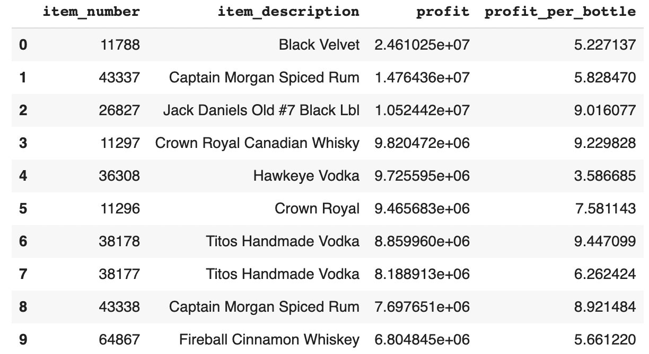
Highest overall profit
Which items have the highest overall profit? What is their profit per bottle
Black Velvet Whiskey contributes the most to overall profit

Slide 9
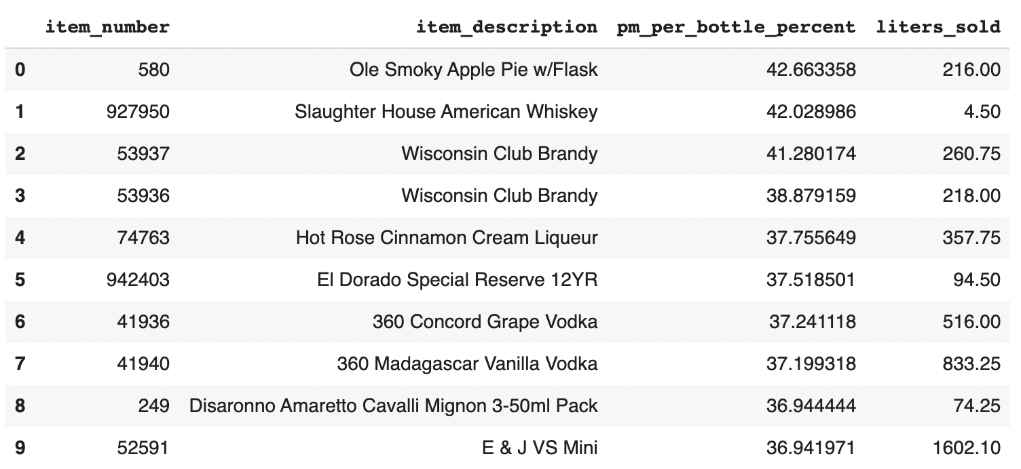
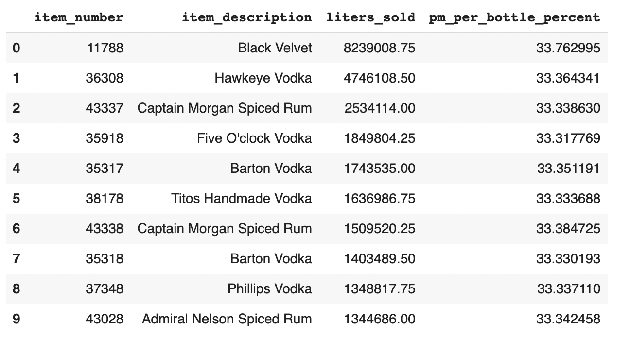
Highest profit margin per bottle
Which items have the highest profit margin per bottle?
The items that have the highest profit margin per bottle have limited demand
Which items were consumed the most in liters? All have profit margins of around 33%

Slide 10
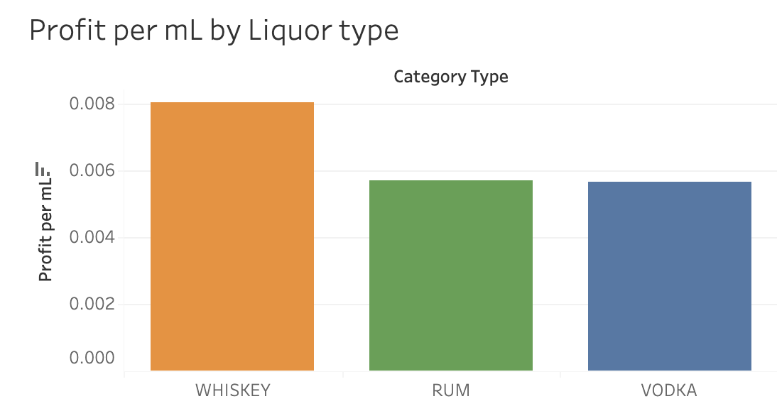
Average profit per mL by category
Using the categories that have the highest demand
Use mL instead of bottle to make it standardized
Best performing liquor based on the average profit per mL is the Whiskey Category

Slide 11
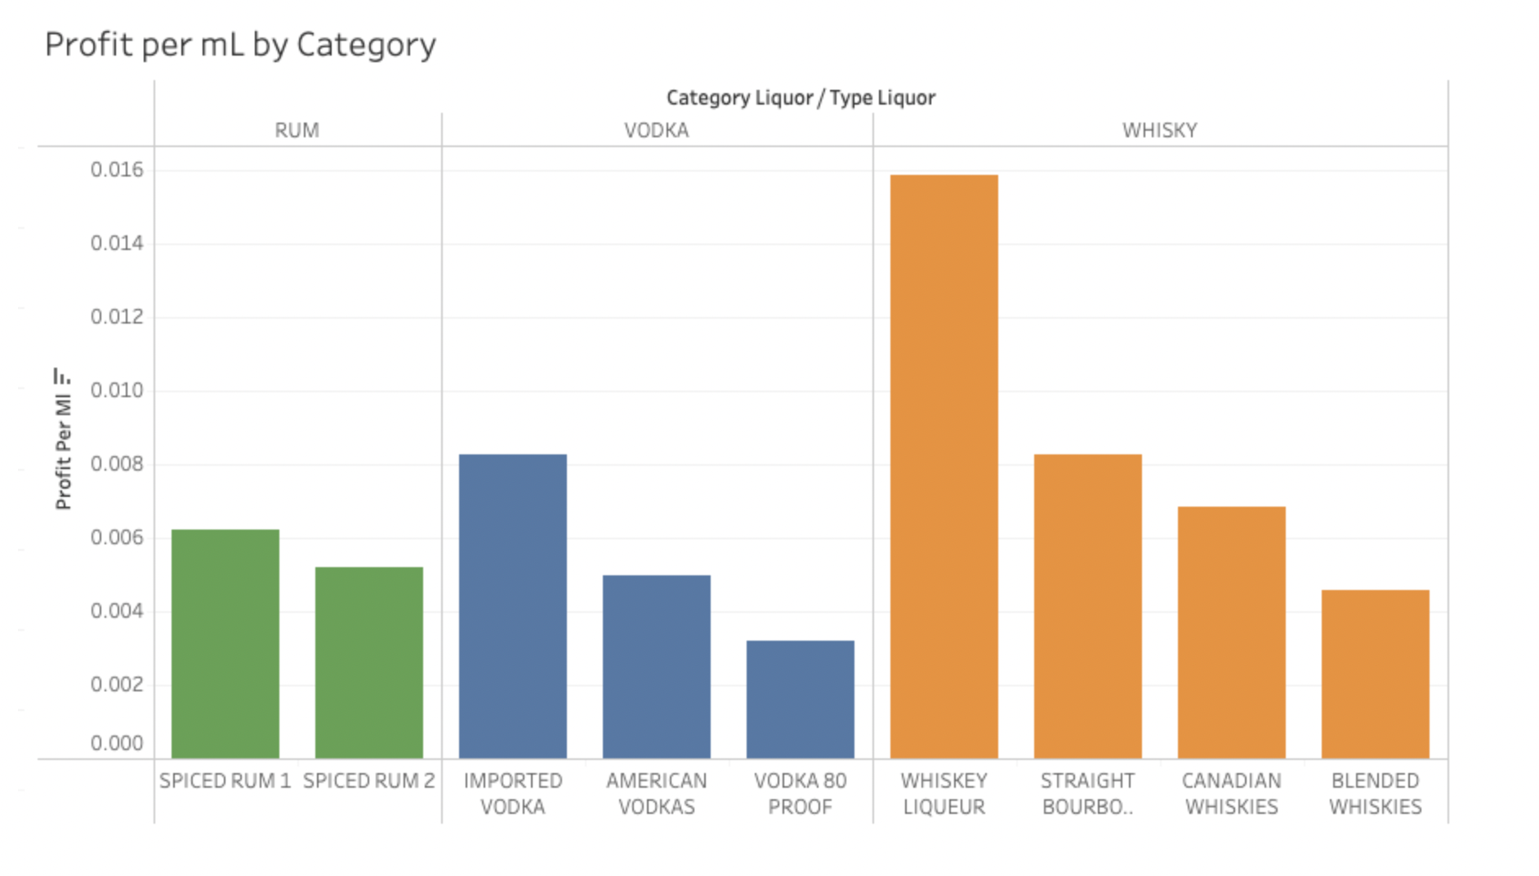
Profit per mL by item
Using the items that had the highest demand
The Whisky liqueur is the best performing item in terms of profit per mL
Imported Vodka is the best performing item in the vodka category

Slide 12
Distribution Analysis

Slide 13
Dashboard Presenting
https://public.tableau.com/app/profile/mohammed.alqenae/viz/ImprovingLiquorProfitoftheIowaAlcoholicBeverageDivision/Comparisonofcategories?publish=yes

Slide 14
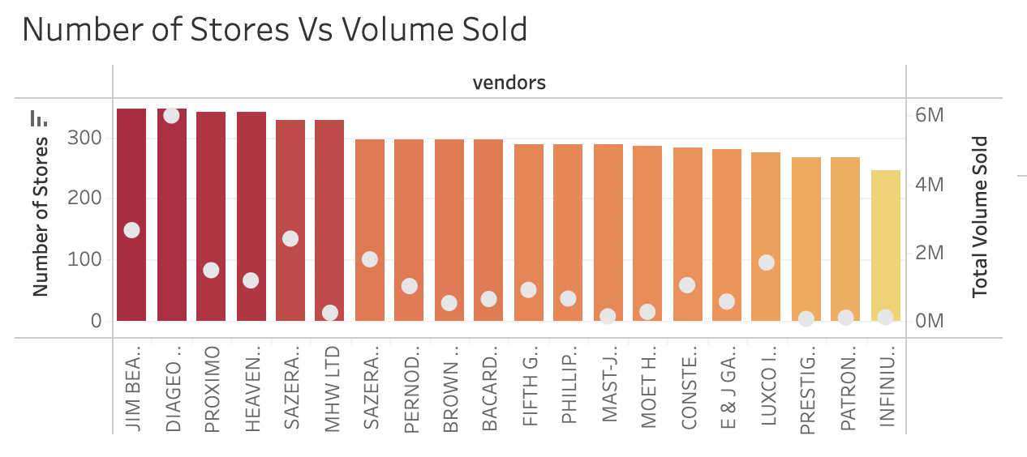
Vendors and their competitions
The largest vendors is Diageo America and Jim Beam Brands in terms of volume sold and numbers of stores.
Some stores might have high volume liquor sold but lower amount of stores that they supplies to.

Slide 15
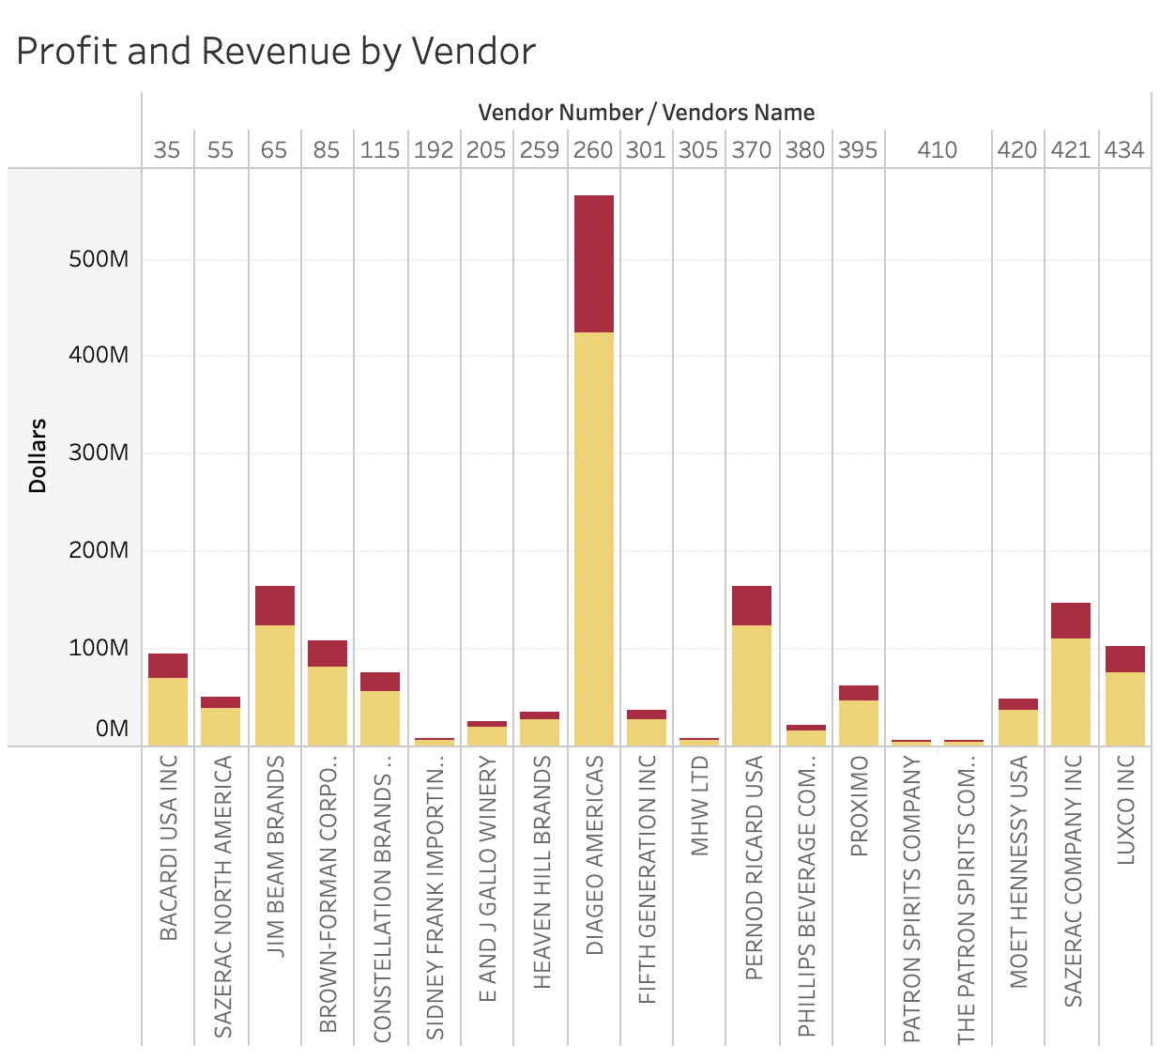
Competitions within the counties
The county with the most highest profit and revenue is Polk County.
Some county after filter, has only one vendor or we can say that the vendor acts like a monopoly of the area that cover the most supplying of liquor. For example, Cerro Gordo and Dickinson.

Slide 16
Continue...
Narrowing down to Stores
What are the most popular Stores???
Benchmark for marketing, optimizing wholesale….

Slide 17
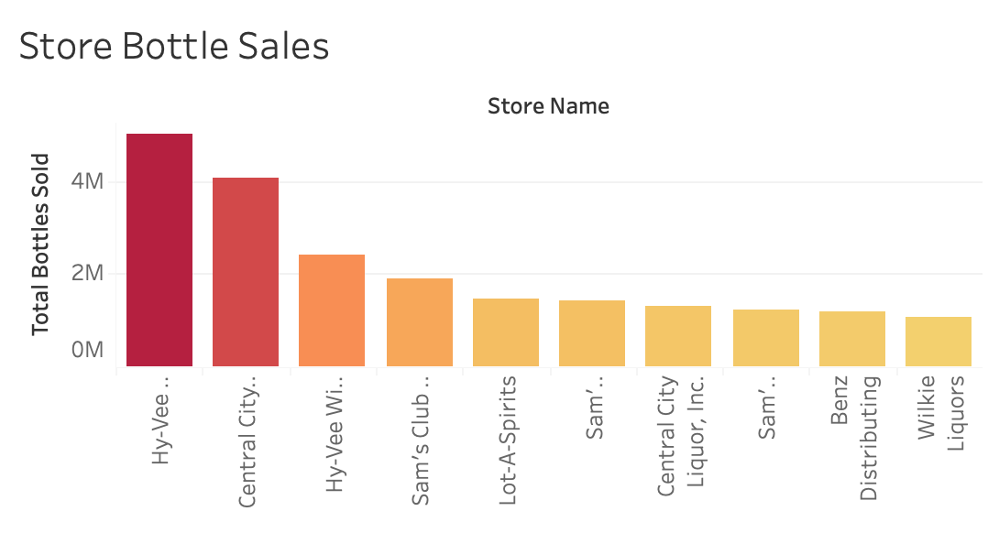
Top 10 popular stores
The most popular store is Hy-Vee with bottle sales of 5,004,198.
Following by Central city (4,076,104 bottles) and Sam’s Club (1,427,538 bottles)

Slide 18
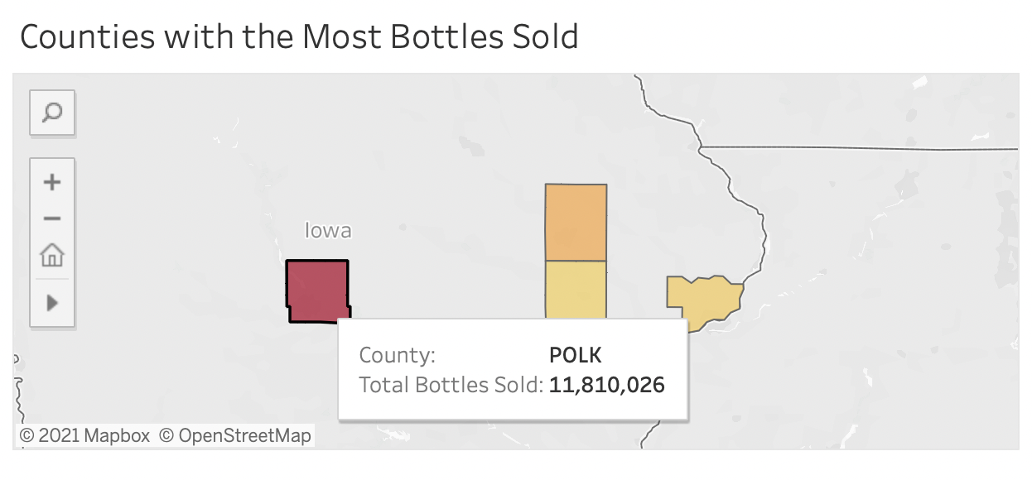
Filter by County

Slide 19
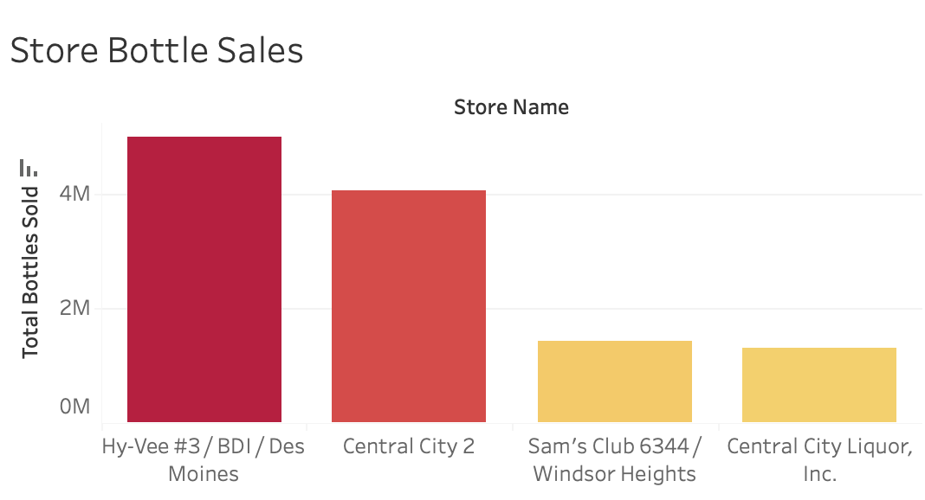
After filtering..

Slide 20

Our Recommendations
01
Promote the sale of whisky over vodka or rum
02
Change the liquor mix to prioritize:
Whisky Liqueur
Imported Vodkas
Spiced Rum
03
Focus more on supporting vendors with the most volume sold instead of the number of stores they supplied
Targeting minimizing costs of distribution by consolidating
Notes:
The effect of replacing liquor mix by 1% of current volume versus 10% on the profit and liters sold to profit ratio.
Promote the sale of whisky over vodka or rum
Change the liquor mix to prioritize:
Whisky Liqueur
Imported Vodkas
Spiced Rum
Focus more on supporting vendors with the most volume sold instead of the number of stores they supplied
Targeting minimizing costs of distribution by consolidating

Slide 21
Q & A :)

Slide 22
Thank You!

